Slide 1
Inferential Statistics
Inferring about the population with the help of sample is called inferential statistics
Hypothesis Testing

Slide 2
Hypothesis – Assumption
Practical problem
Mathematical Problem
Mathematical Solution
Practical Solution

Slide 3
Null Hypo : H0 : All 100 laddus are Good
Alternate Hypo : H1 : All 100 laddus are bad
Accused
100 laddus
Population
Good
Bad
Guilty Innocent
H0 is TRUE
H0 is FALSE , H1 is True
Punish
Buy
Judge
Accept H0
We
Confidence Level (1-alpha) (.95,.90,.99)
TYPE II Error
Evidence
Release
Consumer’s risk (beta)
Sample(1)
Not Buy
Reject H0
TYPE I Error
Power of hypothesis Test
Producer’s risk
Significance Level (alpha)
(0.05, 0.10, 0.01)

Slide 4
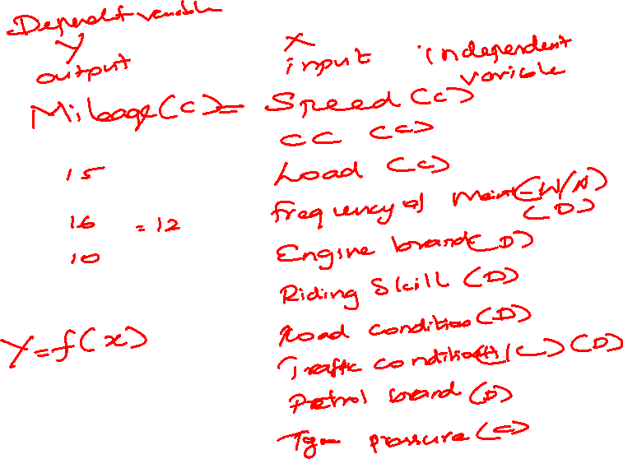
Step 1 : Identify X and Y and Its data type
Step 2 : Set alpha value
Step 3 : Select the Hypothesis Test
Step 4 : Frame Hypothesis
Step 5 : Perform Test
Step 6 : Find P value
Step 7 : Compare p value with alpha
Step 8 : Accept/ Reject Null Hypothesis
Step 9 : Conclusion
If p value is lower than alpha Reject Null
If p value is higher than alpha Accept null
P high Null fly
P low Null go

Slide 5
A financial analyst at a Financial institute wants to evaluate a recent credit card promotion. After this promotion, 500 cardholders were randomly selected. Half received an ad promoting a full waiver of interest rate on purchases made over the next three months, and half received a standard Christmas advertisement. Did the ad promoting full interest rate waiver, affects purchases?
Step1:
Y = amount of Purchases (C)
X = ad promotion (FIW/SCO) (D)
Step 8 : P value is low than alpha
Step 9 : Reject Null
Ad promotion affects the purchase
Step 2 : 0.05
Step 3 : 2 – sample t test ( y-C, X,D &2 )
Step 4 : Frame Hypothesis
H0 : X does not affect Y : muF = muS
H1 : X affect Y : muF != muS
Step 5 : Perform test
Step 6 : p value = 0.024
Step 7 : 0.024 | 0.05

Slide 6
A marketing organization outsources their back-office operations to three different suppliers. The contracts are up for renewal and the CMO wants to determine whether they should renew contracts with all suppliers or any specific supplier. CMO want to renew the contract of supplier with the least transaction time. CMO will renew all contracts if the performance of all suppliers is similar
Y – Transaction Time (C)
X – Supplier (A/B/C) (D)
Alpha = 0.05
One way ANOVA (Y- C & x- D (3 or more sample)
H0: X does not affect Y ( muA= mub = muC)
H1: X affect Y (muA!= mub != muC)
pvalue=0.103
P is high
Null Accepted
Conclusion : Suppliers doesn’t affect transaction time
All the Suppliers have equal transaction time
Renew All the Suppliers

Slide 7
An statistician wants to determine whether the monthly expenditure cost for families has changed from the previous year, when the mean cost per month was $300. The statistician randomly samples 28 families and records their expenditure costs for the current year.
Y – Expenditure Cost (C)
X – Year(Current year/ Pr year) (D)
Alpha = 0.05
1 sample t test
Ho: X doesn’t affect Y (muC = 300)
H1 : X affect Y (muC != 300)
Perform test
P value – 0.208
P high
Null Accepted
Expenditure cost is equal to previous year

Slide 8
Y Continuous and X Discrete
Comparing 1 Sample vs STD
Comparing 2 samples
Comparing 3 or more samples
Normality test
One sample t test
Normality test
Two sample t test
Normality test
One Way ANOVA

Slide 9
A poll is carried out to ﬁnd the acceptability of new football coach by the people. It was decided that if the support rate for the coach for the entire population was truly less then 25%, the coach would be ﬁred
• 2000 people participated and 482 people supported the new coach
• Conduct a test to check if the new coach should be ﬁred with 90% level of conﬁdence
Y – poll Result (D)
X – Current / (25%) (D)
Alpha = .10
1 proportion test
H0: X doesn’t affect Y (pC = .25)
H1: x affects Y (pC != .25)
P value = 0.34
P high
Null accept
Cannot fire the coach

Slide 10
Johnnie Talkers soft drinks division sales manager has been planning to launch a new sales incentive program for their sales executives. The sales executives felt that adults (>40 yrs) won’t buy, children will & hence requested sales manager not to launch the program. Analyze the data & determine whether there is evidence at 10% significance level to support the hypothesis
P value = 0.00013
P low
Null Rejected
Children is buying more than the adult
Do not launch the program
Y – Sales (B/N) (D)
X – Age(A/C) (D)
Alpha = 0.10
2 proportion test
H0: X doesn’t affect Y (pA = pC)
H1: X affects Y (pA!= pC)

Slide 11
Bahamantech Research Company uses 4 regional centers in South Asia (India, China, Srilanka and Bangladesh) to input data of questionnaire responses. They audit a certain % of the questionnaire responses versus data entry. Any error in data entry renders it defective. The chief data scientist wants to check whether the defective % varies by country. Analyze the data at 5% significance level and help the manager draw appropriate inferences. [‘0’ means not defectives & ‘1’ means defective]
y – Defects (D)
x – country(I/C/S/B) (D)
alpha - 0.05
Chi square test
Ho: X doesn’t affect Y ( pI =pB= pC = pS)
H1:X affects Y (pI != pB != pC != pS)
P value = 0.63
P high
Null Accepted
Defects percentages are same for all the countries

Slide 12
Y Discrete and X Discrete
Comparing 1 Sample vs STD
Comparing 2 samples
Comparing 3 or more samples
1 proportion test
2 Proportion test
Chi square test

Slide 13
Do the test and find results
Find whether the average mileage driven by you is equal to 40KMPh for your data. (note Use =NORM.INV(RAND(),30,2.5) in excel to generate data. Take at least 50 rows of data)

Slide 14
Do the test and find results
Find whether the average mileage driven by you is equal to 40KMPh for your data. (note Use =NORM.INV(RAND(),30,2.5) in excel to generate data. Take at least 50 rows of data)

Slide 15
Do the test and find results
Find whether there is any significance difference in mileage between you and your driver while riding in the motor vehicle.
(note: Use =NORM.INV(RAND(),35,.4) in excel to generate data for you.
Use =NORM.INV(RAND(),33,3) in excel to generate data for your Driver.
Take at least 50 rows of data)
Take decision whether to fire the driver because of the transportation cost

Slide 16
Do the test and find results
Test whether changing your the tyre pressure affects your milage or not.
(note: Use =NORM.INV(RAND(),34,1) in excel to generate data for 30 PSI.
Use =NORM.INV(RAND(),36,3) in excel to generate data 33 PSI.
Use =NORM.INV(RAND(),37,2) in excel to generate data 35 PSI.
Take at least 150 rows of data)
Find out the best tyre pressure to have.

Slide 17
Do the test and find results
Test whether driving on different road condition changes your mileage or not
(note: Use =NORM.INV(RAND(),15,1) in excel to generate data for Gravel
Use =NORM.INV(RAND(),20,2) in excel to generate data Asphalt.
Use =NORM.INV(RAND(),17,4) in excel to generate data Cement.
Take at least 200 rows of data)
Find out the right road condition to drive on.

